Slide 1

WIPRO NGA Program – Java Full Stack
Capstone Project Presentation –29th Aug
Project Title Here - Library Management Service
Presented by - Faizan Aslam (31158)
www.rpsconsulting.in

Slide 2
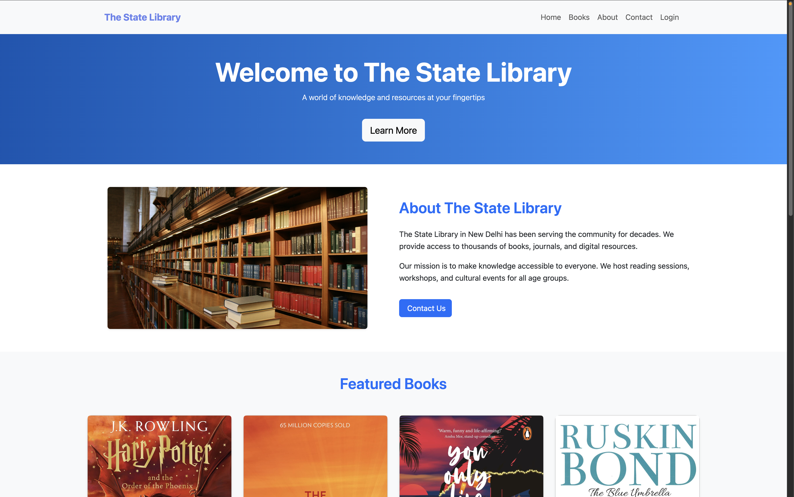

Project Demo
2025 - RPS Consulting all rights reserved

Slide 3
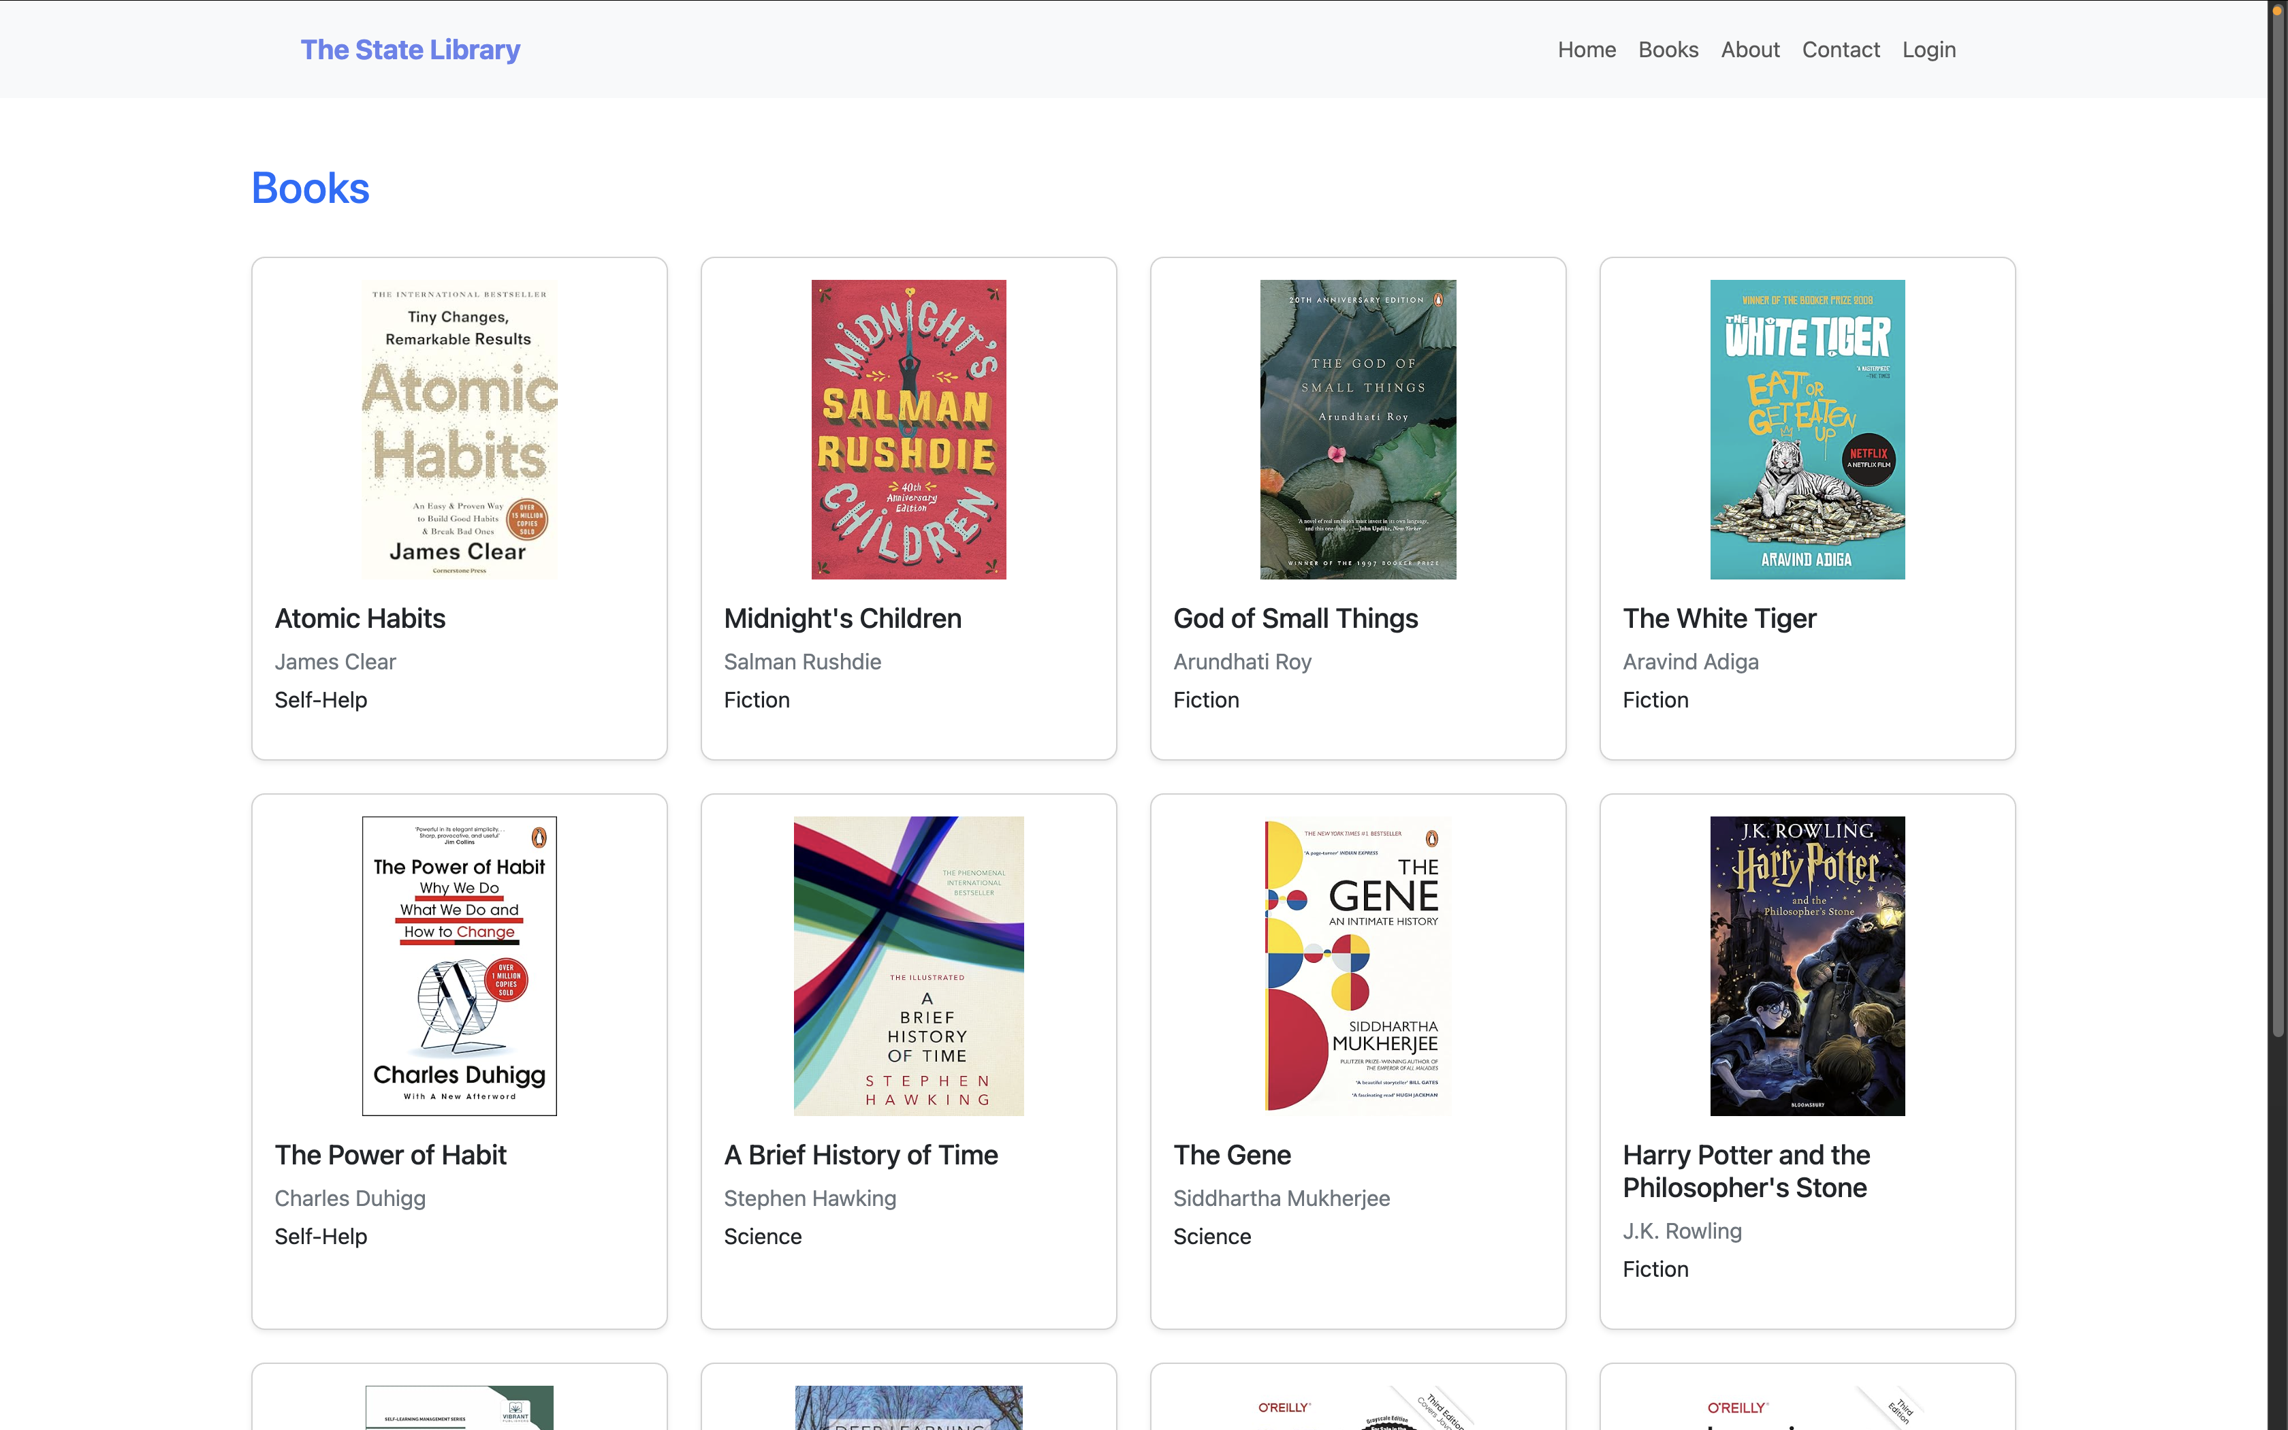
Project Demo
2025 - RPS Consulting all rights reserved

Slide 4
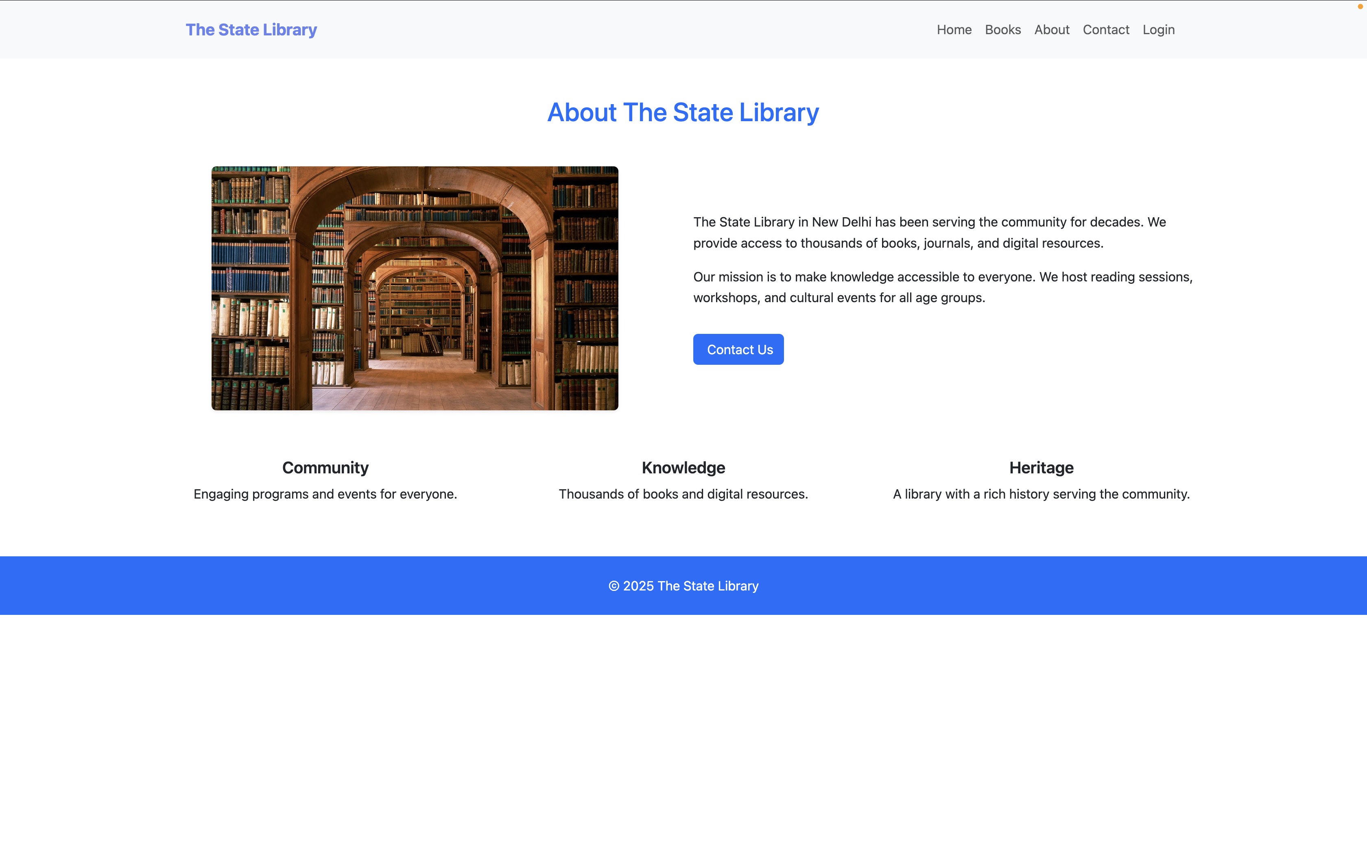
Project Demo
2025 - RPS Consulting all rights reserved

Slide 5
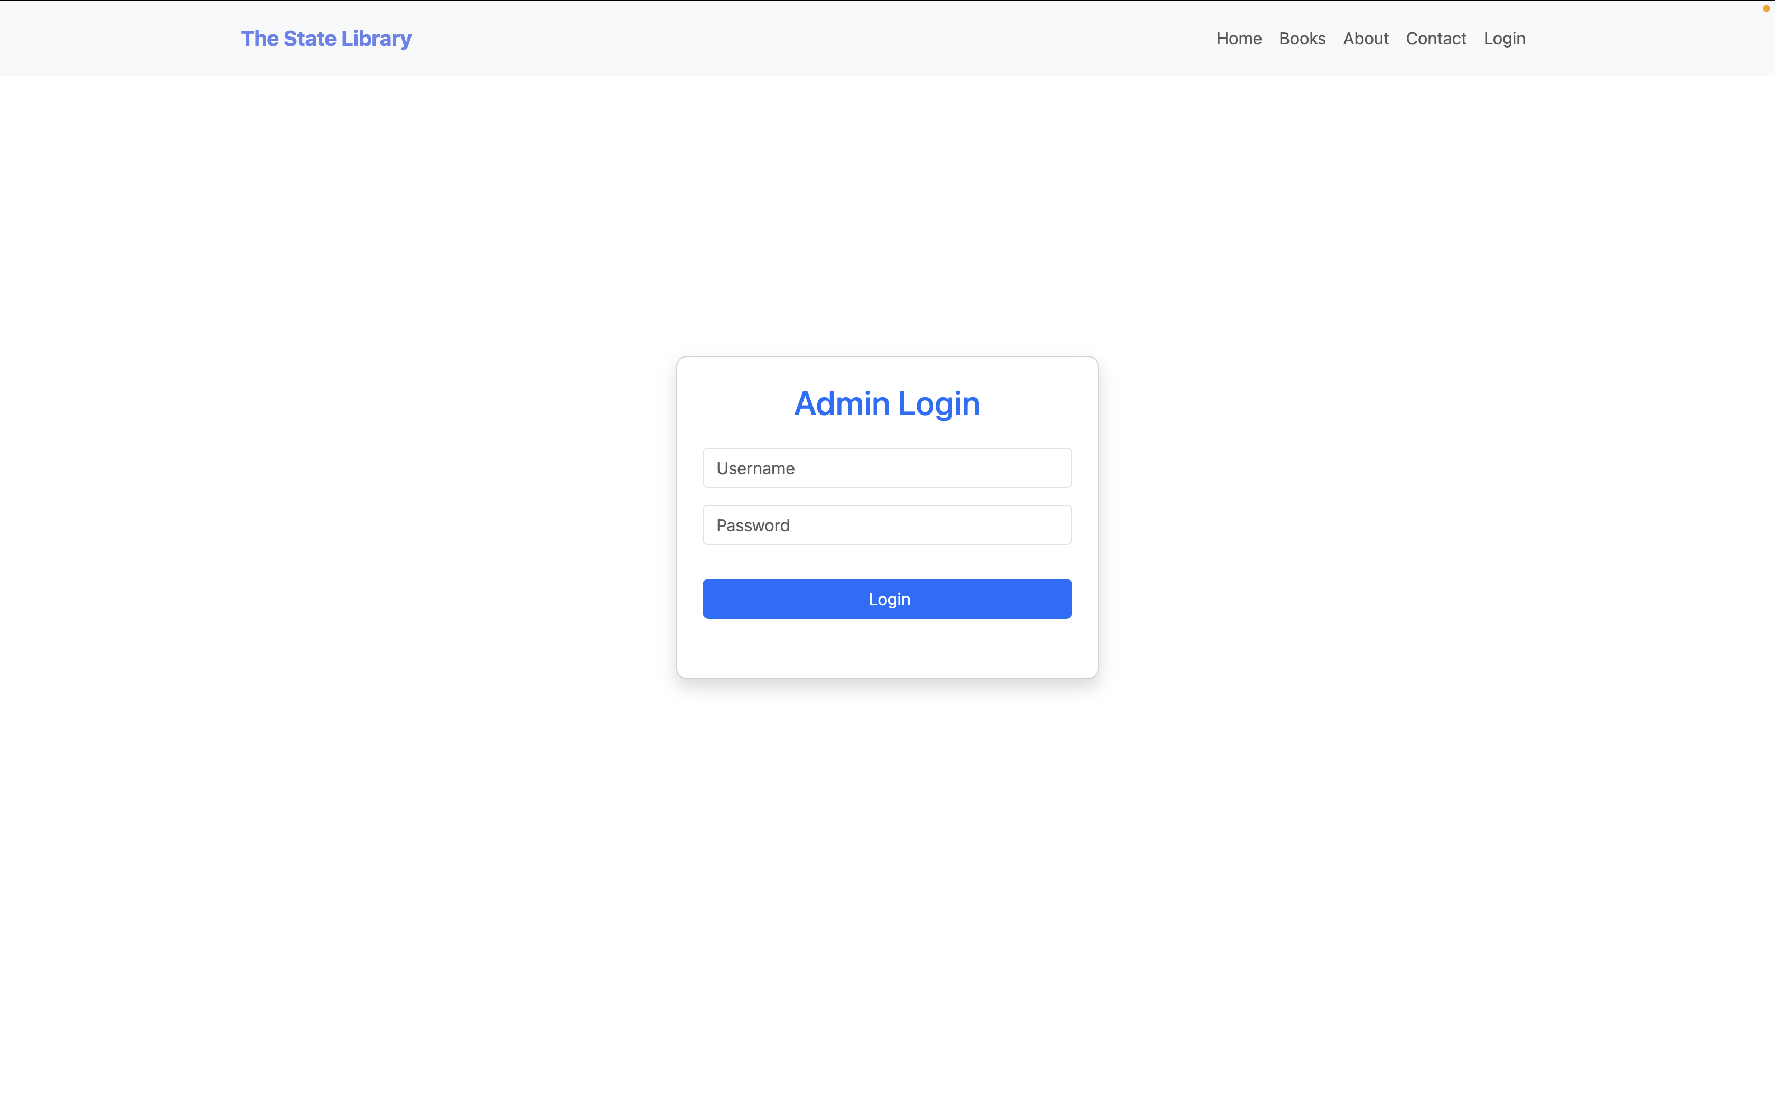
Project Demo
2025 - RPS Consulting all rights reserved

Slide 6
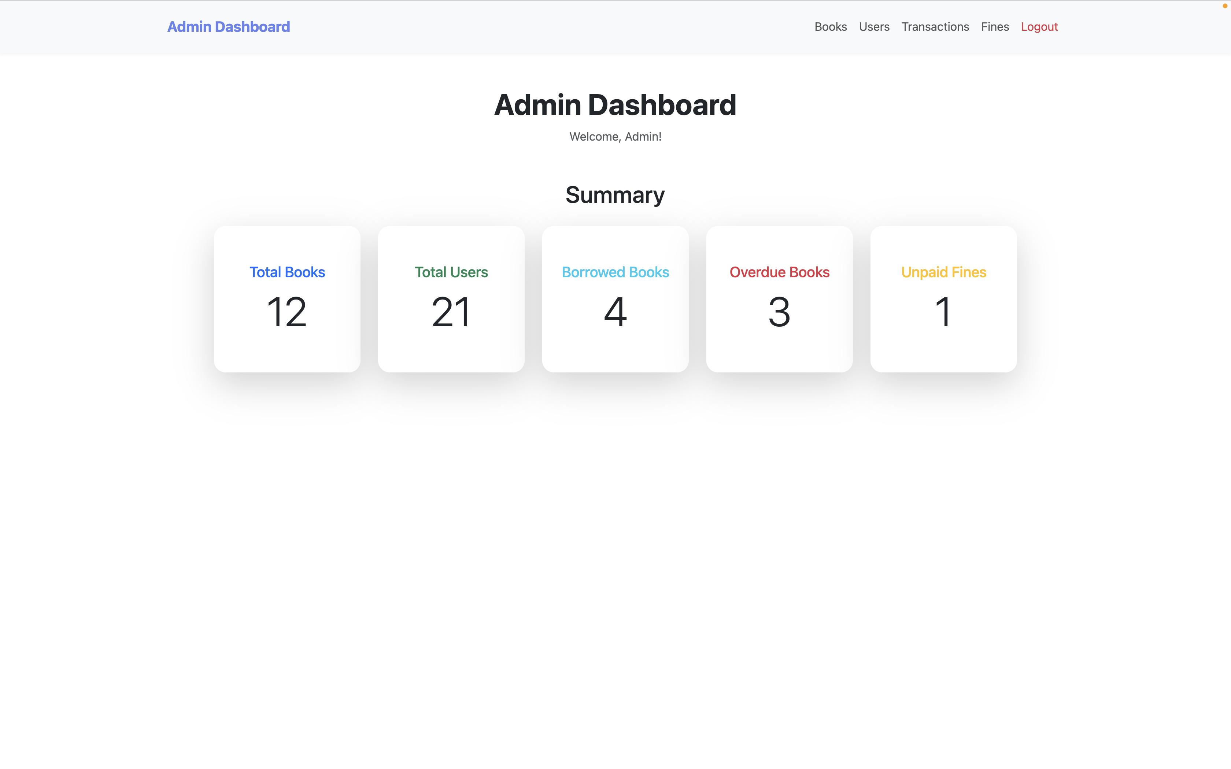
Admin Dashboard
2025 - RPS Consulting all rights reserved

Slide 7
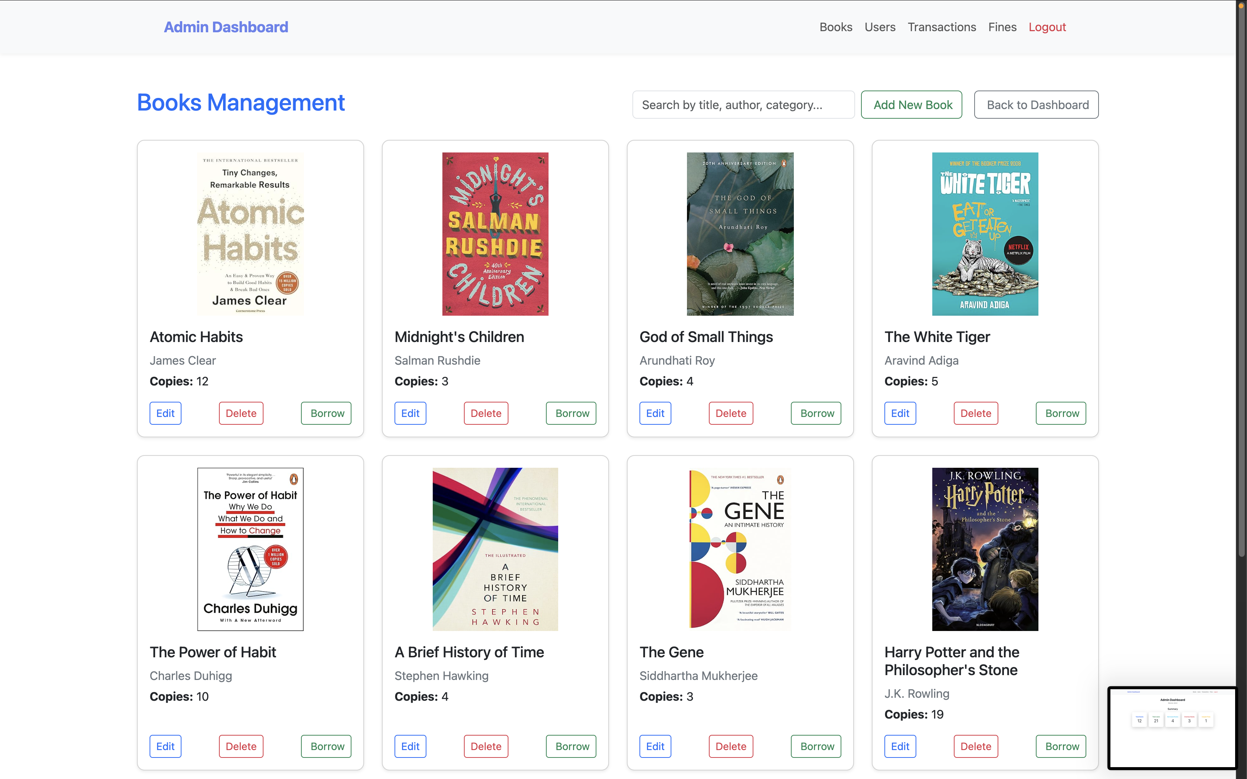
Admin Page
2025 - RPS Consulting all rights reserved

Slide 8
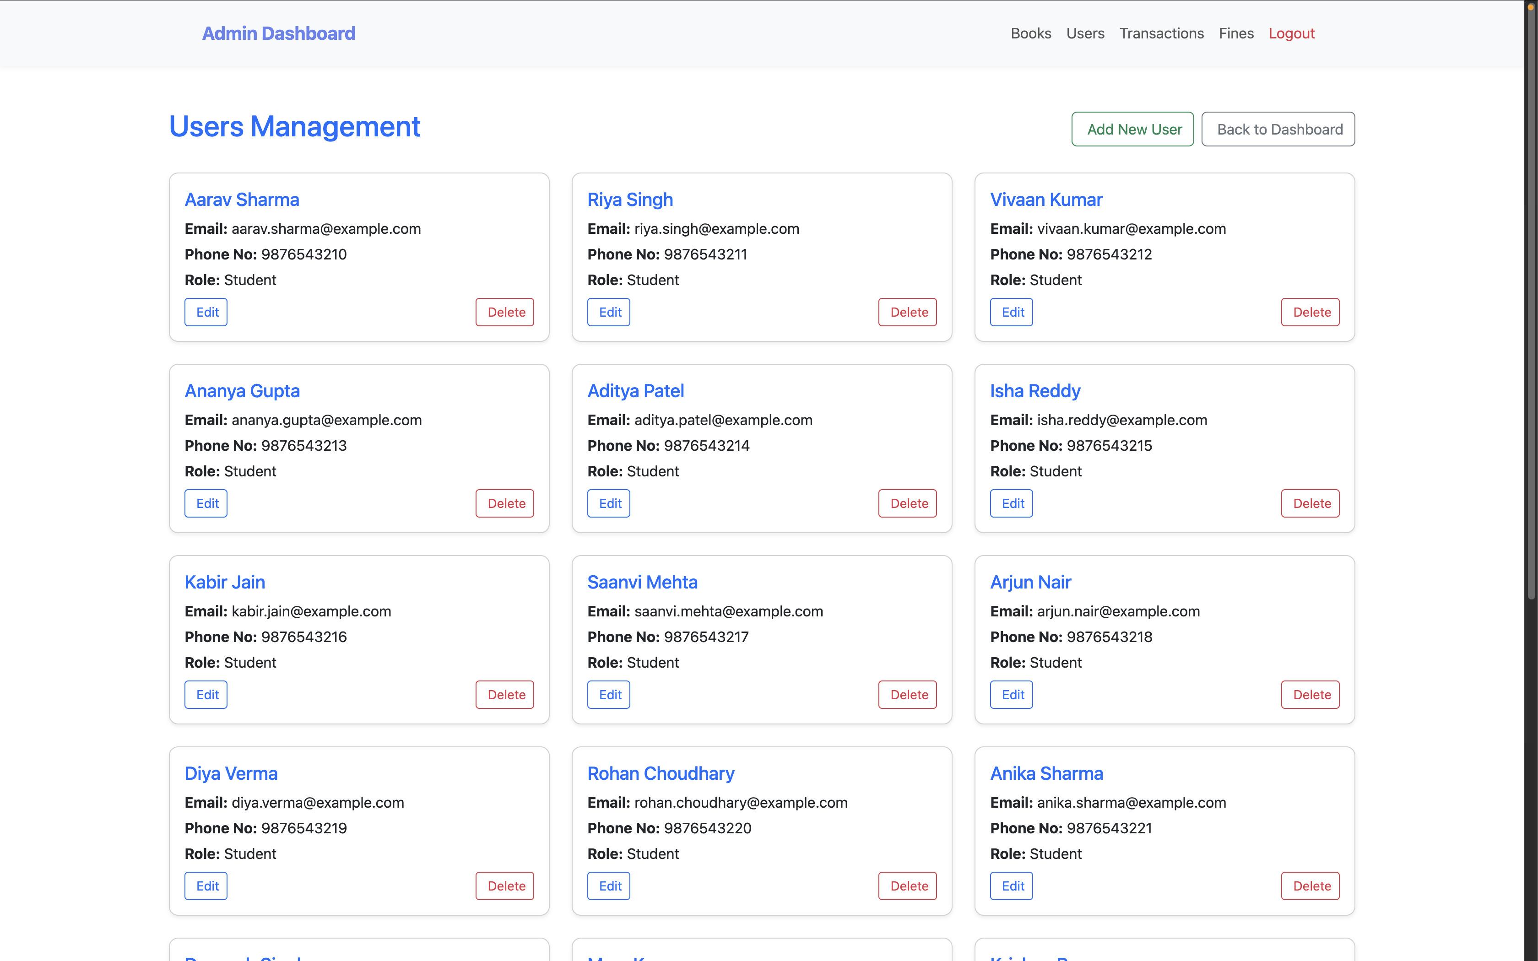
Admin Page
2025 - RPS Consulting all rights reserved

Slide 9
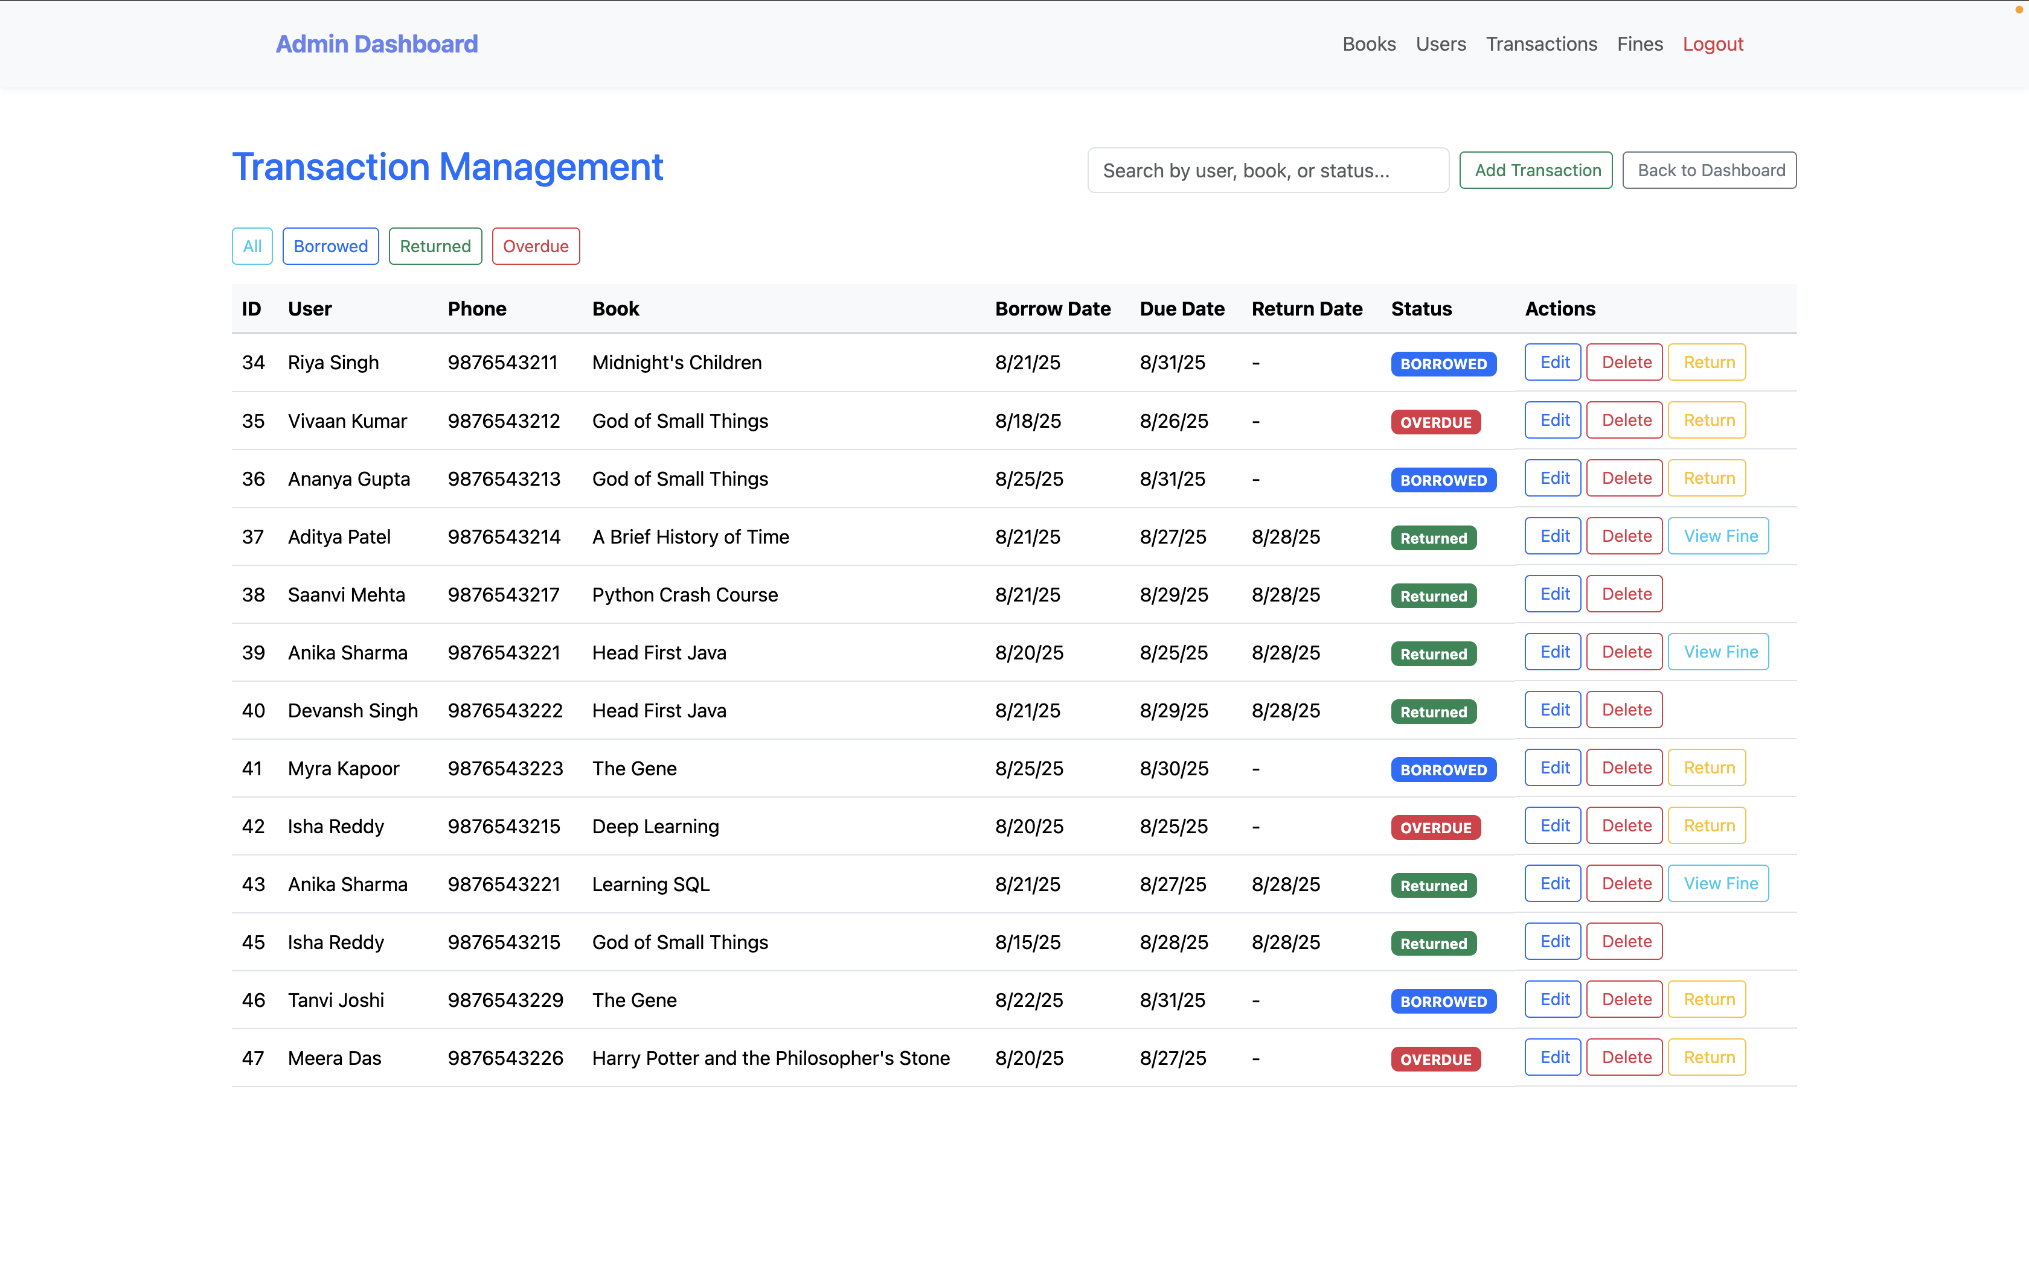
Admin Page
2025 - RPS Consulting all rights reserved

Slide 10
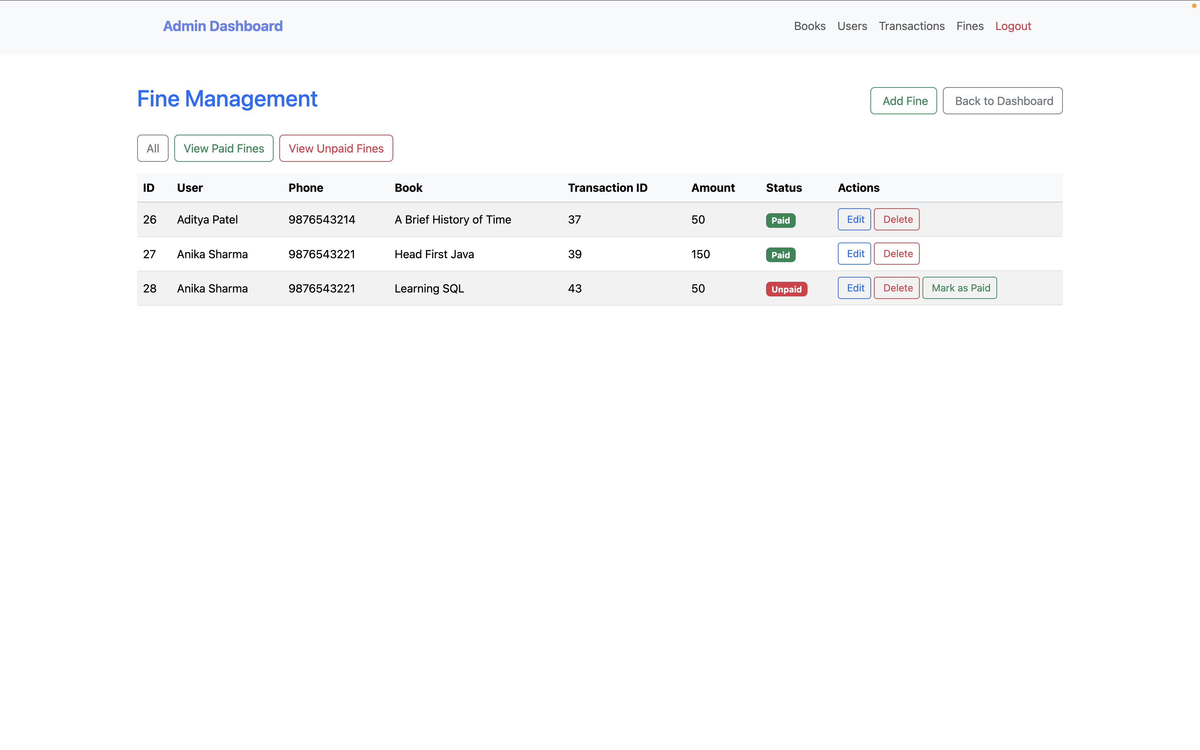
Admin Page
2025 - RPS Consulting all rights reserved

Slide 11
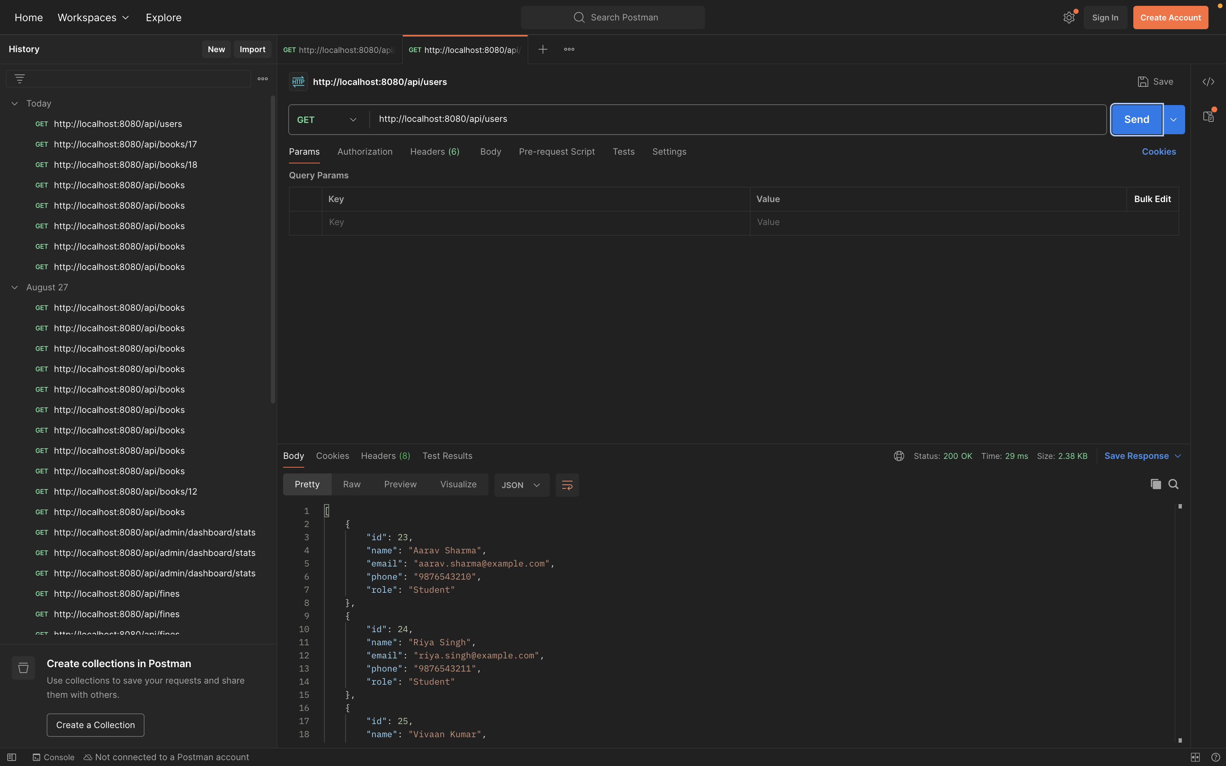
API Testing
2025 - RPS Consulting all rights reserved

Slide 12
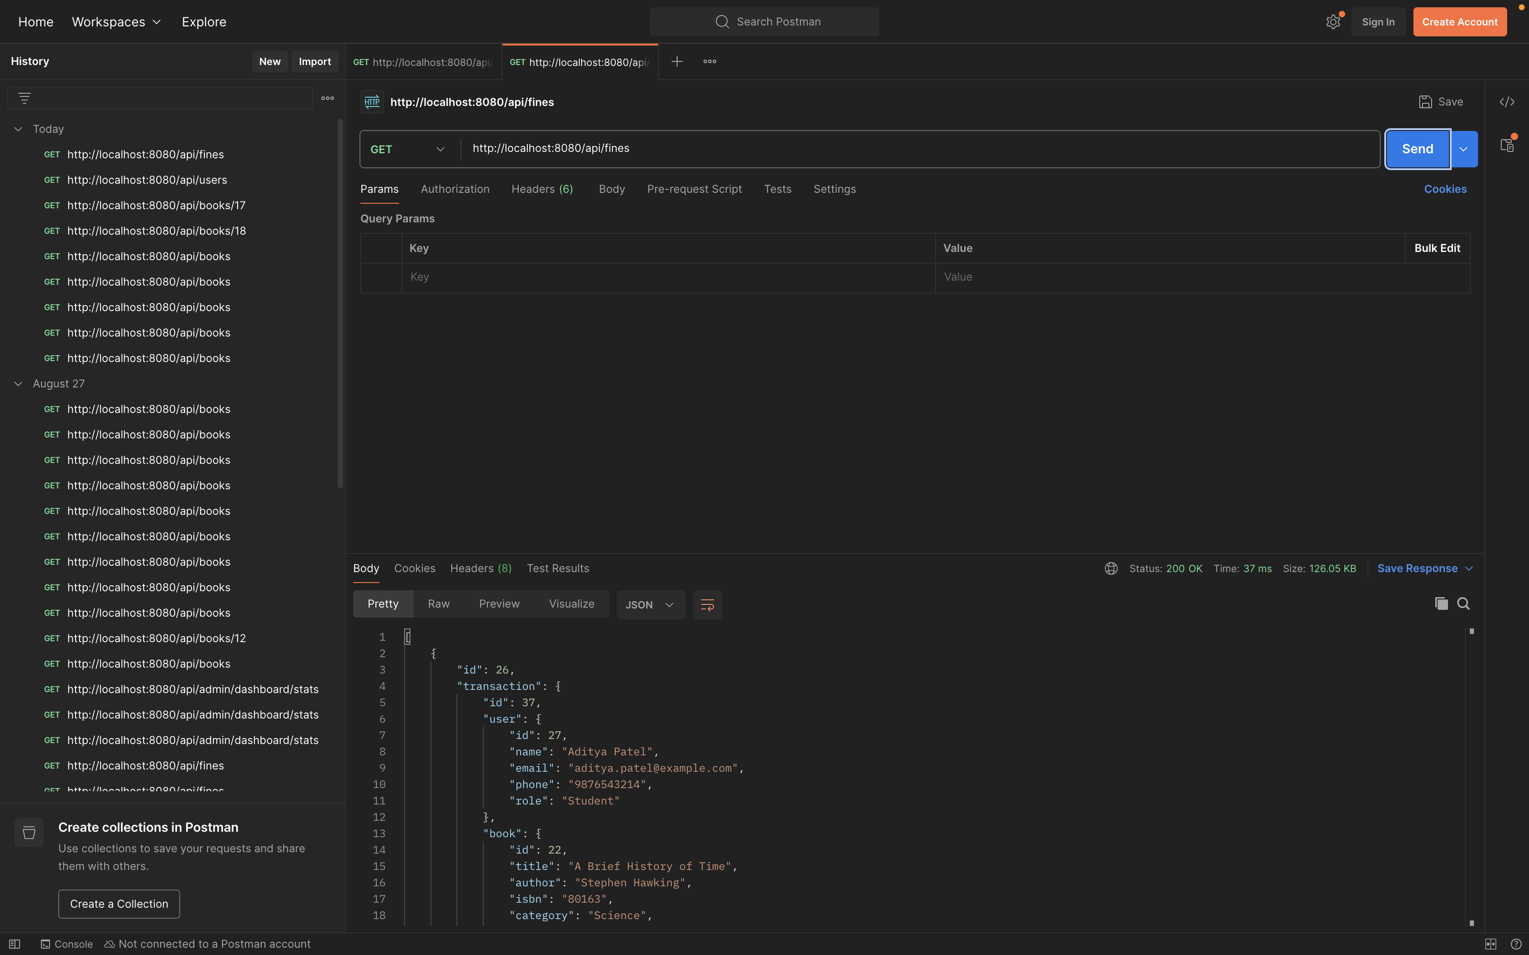
API Testing
2025 - RPS Consulting all rights reserved

Slide 13
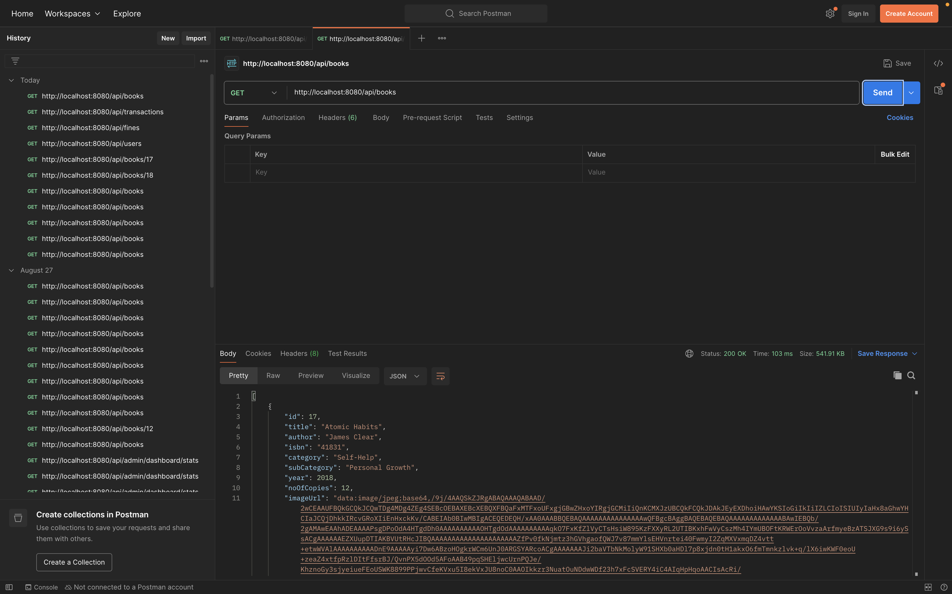
API Testing
2025 - RPS Consulting all rights reserved

Slide 14
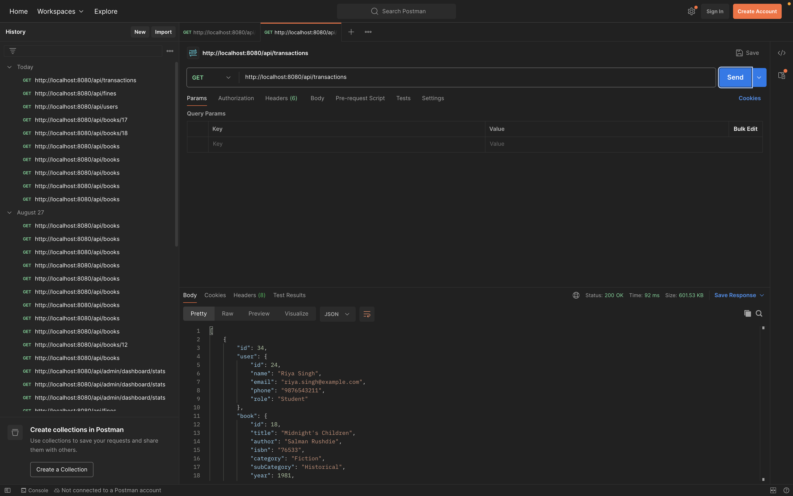
API Testing
2025 - RPS Consulting all rights reserved

Slide 15
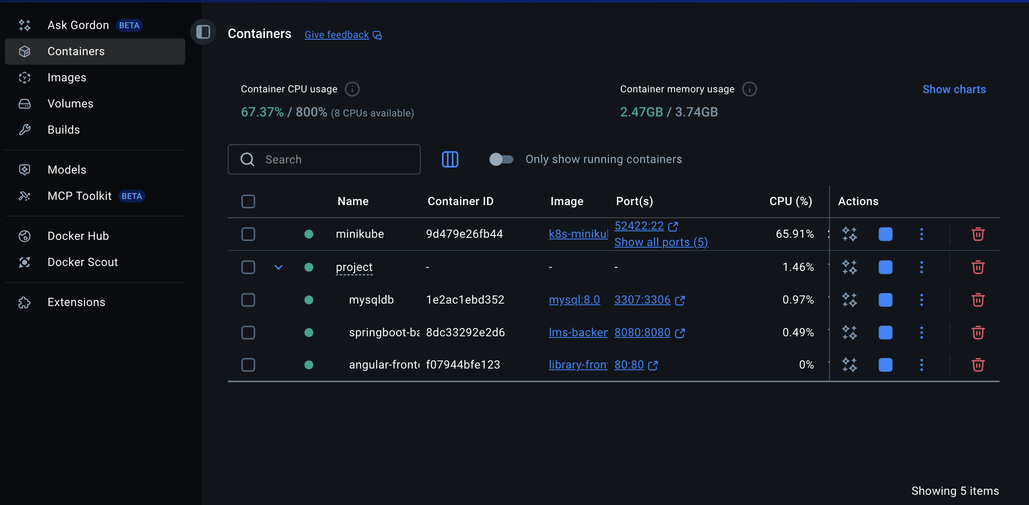
Deployments
2025 - RPS Consulting all rights reserved

Slide 16
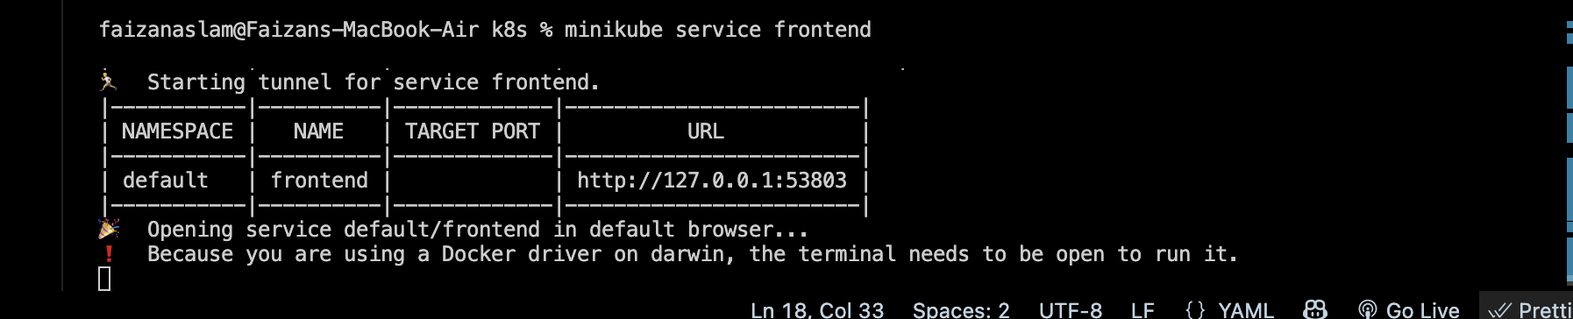
Deployments
2025 - RPS Consulting all rights reserved

Slide 17
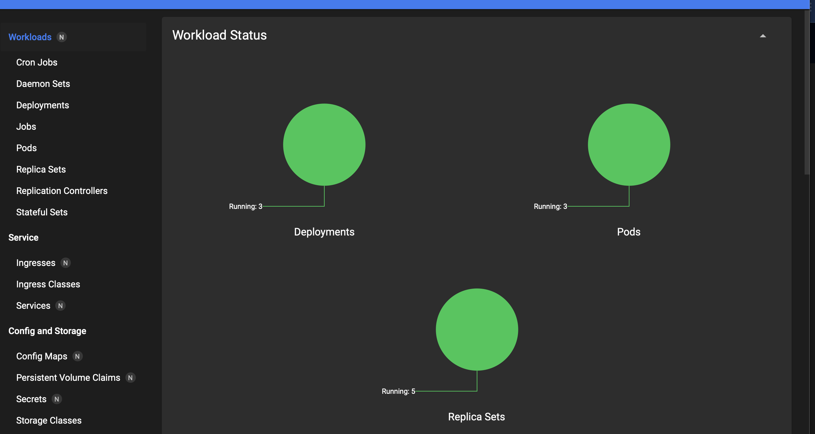
Deployments
2025 - RPS Consulting all rights reserved

Slide 18
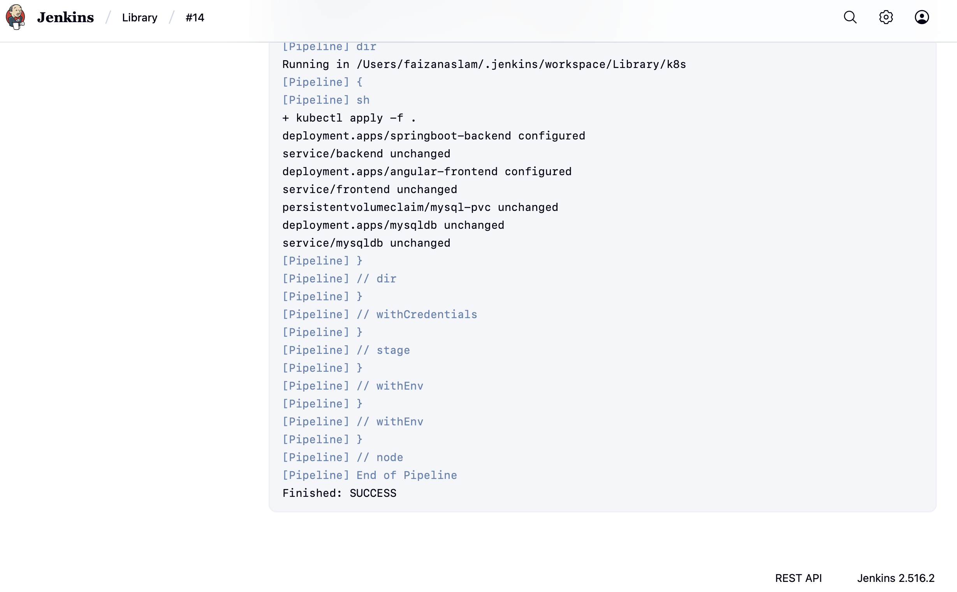
Deployments
2025 - RPS Consulting all rights reserved

Slide 19
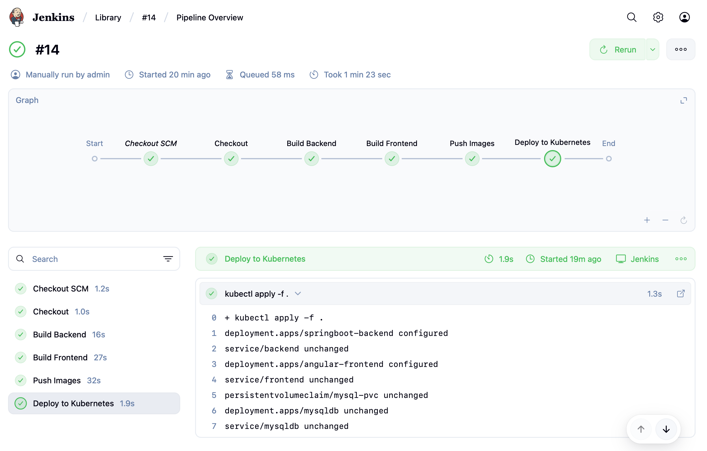
Deployments
2025 - RPS Consulting all rights reserved

Slide 20
THANK YOU

